Slide 1
Lecture 17 October 10, 2019
Exam 2 Monday.
Problem set(s) posted. Solution—will post Sunday afternoon/evening. You know the routine---do the problems without the key.
Topics list today.

Slide 2
Help wanted—2 volunteers. More is fine! Let me know..
I could use a pair of students who could help with the first crosses of Drosophila---it requires collecting virgin females and special attention to timing and good observation skills.
Estimated 2-4 1-hour sessions of collecting female flies. Flexible times. Lots of instruction from me.
Email or drop by my office if interested.

Slide 3
We will be following a cross of:
Female y, cv, f X male wild-type
Each pair will be responsible for setting up 2 vials. You will collect your own males. The helpers will help collect virgin females (or you can also do this yourselves)
More info Monday

Slide 4
https://www.nobelprize.org
It’s Nobel Prize week!!!
Prize in Medicine and Physiology-—3 scientists who study hypoxia. Low oxygen.
Nobel Prize in Physics—For discovery of first planet orbiting a star in a solar system outside our own.
Nobel Prize in Chemistry—for development of lithium-ion batteries. Thank them when recharging ANYTHING today.

Slide 5
Next week will discuss…
Literature---
Peace---

Slide 6
Where were we?....
Extensions of Mendel’s observations…
Extension #2. Incomplete or partial dominance. A few traits are controlled by genes for which neither allele is completely dominant.

Slide 7
#3 Co-dominance For some traits, heterozygotes express different alleles equally
e.g. Several molecules found on red blood cells show co-dominant expression (on board)
MN blood group 2. ABO blood group
(Both referred to as cell surface antigens)

Slide 8
Important terminology
Cell surface molecules are often referred to as antigens, if they can be bound/detected by specific antibodies.
Antibodies can be used to detect antigens we cannot see with eye directly.
antibody
Antigen

Slide 9
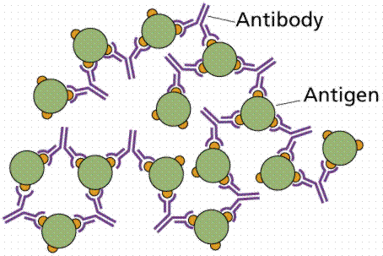
For example…Agglutination (in vitro assay---outside of the organism)

Slide 10
ABO blood group antigens
Antigen used commonly to determine common “ blood type”
Example of 2 extensions of Mendel’s observations.
1. Co-dominance (and complete dominance)
2. Trait controlled by a gene with 3 alleles in the population. Gene is called isoagglutinogen gene.

Slide 11
Summarize Genotypes and Phenotypes
Genotype Gene product Phenotype/Blood type
I^{A}I^{A} A sugar/antigen A
I^{A}I^{O} A sugar/antigen A
I^{B}I^{B} B sugar/antigen B
I^{B}I^{O} B sugar/antigen B
I^{A}I^{B} A and B sugar/antigen AB
I^{O}I^{O} neither A nor B sugar/antigen O

Slide 12
Test your understanding. What type of offspring are possible? What are theoretical expectations? Do this! Practice! Show Punnett square!
AXA
B X B
A X B
O X O
AB X AB
A X O
B X O
A X AB
B X AB
O X AB
Set up your punnett square in ways that test all possibilities of genotypes.

Slide 13
Practical application?...
Blood type is often used to determine if an individual could be the parent of a child.
e.g. Paternity cases, babies switched in hospital
Can only rule out an individual as a parent, not prove that he/she is. Why?

Slide 14
Why do we care about ABO blood group?
Until medical technology advanced to allow blood transfusions, we didn’t care, because hadn’t detected them yet.
But…During the first transfusions, ABO antigens were actually discovered because agglutination occurred in the recipient of the donated blood cell. Agglutination in vivo is fatal.

Slide 15
So…what happened?
Some immunology background….Usually white blood cells called B-cells produce antibodies only after something foreign enters our bodies---like a virus.
Antibodies are very specific and bind the foreign antigen to inactivate it.

Slide 16
In fact, we coaxed mice into making the antibodies against human A- , B-, and D-antigen to use in our lab. The antigens are foreign to mice so they make antibodies—as if they are being attacked by a pathogen.
We can then just take the serum from these mice and use it in ABO blood typing.

Slide 17
But why would humans have these antibodies in their serum.
Unusual phenomenon. Humans make anti-A and anti-B antibodies without known prior exposure to the antigens.
Cause rbcs to agglutinate (clump together)
Fatal in blood transfusions with incompatible blood types

Slide 18
Summary of all blood types
Blood type rbc antigen antibody produced result as transfusion recipient
A A anti-B agglutinates B RBCs
B B anti-A agglutinates A RBCs
AB A and B none no agglutination
O no A nor B anti-A and anti-B agglutinates A, B, AB RBCs

Slide 19
Blood type compatibility---practice!
Must consider 2 things before blood transfusions
Which, if any antigens are on the rbcs of the donor? (Donor only gives cells)
Which, if any antibodies will be present in the recipient's serum. (donors cells will combine with the recipient’s serum)

Slide 20
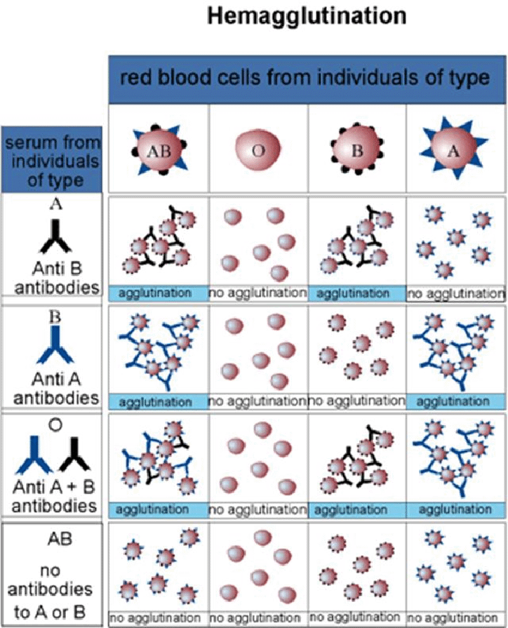

Slide 21
Try the blood typing game at: Nobelprize.org
http://www.nobelprize.org/educational/medicine/bloodtypinggame/

Slide 22
Other important rbc antigens…
Another antigen, called D-antigen/rhesus factor/Rh factor is present on rbcs
Controlled by other genes (not I-gene)
Some people express Rh antigen on rbcs (Rh-positive), some lack the antigen (Rh-negative)
Important in women during pregnancy
Fatal condition for fetus in cases of Rh incompatibility

Slide 23
Rh incompatibility
Rh-negative mother conceives an Rh-positive child.
Normally blood from fetus and mother never comes in direct contact because of the placenta
At birth, however, placenta often ruptures and fetal rbcs may enter the mother’s circulation
Mother, who lacks Rh antigen sees it as “foreign” and begins to make anti Rh-antibodies. These antibodies can lyse/destroy rbcs with Rh antigen on them.

Slide 24
No problem?...
The baby is born…no problem for that baby.
Subsequent pregnancies---Rh+ fetuses will produce rbcs with Rh antigen. Mother will now have ability to make antibodies and destroy these cells.
Hemolytic anemia of the newborn. Fatal.

Slide 25
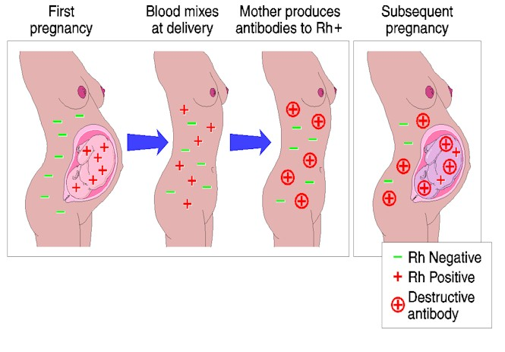

Slide 26
Solution?...
Now can give Rh- mother a substance Rhogam that lyses and destroys any Rh+ fetal cells from the baby before mother can mount her own antibody response.
What is the substance? Dose of anti-Rh antibodies. Seek out baby’s cells and destroy, but do not last long enough to affect a second pregnancy.

Slide 27
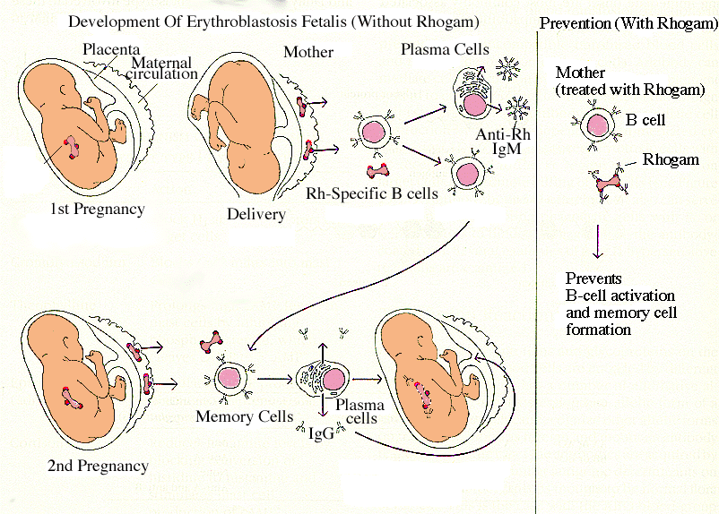
Destroys fetal cells before Mother’s B-cells are activated and begin making antibodies

